Slide 1

Department Of Artificial Intelligence & Data Science
GREEN COMPUTER VISION: ENERGY - EFFICIENT AI THROUGH MODEL OPTIMIZATION
DSA0201 - COMPUTER VISION WITH OPENCV
PRESENTED BY:
GUIDED BY:
Dr. PARIMALA KANAGA DEVAN
Professor CSE
HARINI R (192324108)

Slide 2


INTRODUCTION
Computer vision enables computers to analyze images and recognize objects using artificial intelligence.
Deep learning models often require significant computational resources, memory and electrical power.
Green computing aims to reduce the environmental impact of computing systems through efficient resource utilization.
Model optimization techniques such as image resizing, quantization and pruning can improve the efficiency of computer vision applications.
This project investigates the relationship between image resolution, model optimization, recognition accuracy, inference time, memory usage and energy consumption.

Slide 3
LITERATURE REVIEW
Year of publication | Authors | Title of the paper | Technologies Used | Identified Gaps
2023 | Desislavov, Martínez-Plumed and Hernández-Orallo | Trends in AI Inference Energy Consumption: Beyond the Performance-vs-Parameter Laws of Deep Learning | Examines trends in AI inference energy consumption and the relationship between model performance and computational cost. | Highlights the need to evaluate energy consumption alongside conventional performance measures.
2024 | Hernández, Almeida and Blanco | Optimizing Convolutional Neural Networks for IoT Devices: Performance and Energy Efficiency of Quantization Techniques | Evaluates CNN quantization techniques for performance and energy efficiency on IoT devices. | Results depend on model architecture and deployment hardware; further testing across image resolutions and model configurations is useful.
2024 | Zagitov, Chebotareva, Toschev and Magid | Comparative Analysis of Neural Network Models Performance on Low-Power Devices for a Real-Time Object Detection Task | Benchmarks object-detection models on low-power devices and examines TensorFlow Lite and quantization techniques. | Focuses on object detection and particular hardware setups; comparisons across additional resolution and energy configurations remain relevant.
2025 | Yang and Armour | The Hidden Joules: Evaluating the Energy Consumption of Vision Backbones for Progress Towards More Efficient Model Inference | Evaluates inference energy across 1,200 ImageNet classification models and compares energy use with accuracy. | Broad model-level analysis; a focused interactive comparison of image resolution and quantization for the selected project setup remains useful.
2025 | Isenkul | Energy-Aware Deep Learning for Real-Time Video Analysis Through Pruning, Quantization, and Hardware Optimization | Studies pruning, quantization, and hardware-aware optimization for YOLOv8 and MobileNet. | Focuses on real-time video; single-image classification and resolution-based comparisons could be explored separately.

Slide 4
PROBLEM STATEMENT
Conventional deep learning models can require considerable computational resources for image recognition.
Processing high-resolution images may increase computational workload and inference time.
Model optimization can reduce resource requirements but may also affect recognition accuracy.
The impact of image resolution and model optimization on energy consumption is not always directly comparable across different hardware configurations.
Therefore, a systematic evaluation is needed to identify efficient computer vision configurations that balance energy consumption, computational performance and accuracy.

Slide 5
PROPOSED SYSTEM
Develop an interactive web-based computer vision platform using HTML, CSS, JavaScript and Python.
Use OpenCV to upload, resize and preprocess input images at different resolutions.
Integrate a pre trained MobileNet model to perform image classification.
Apply TensorFlow Lite quantization to create an optimized model and compare it with the baseline model.
Measure and display classification accuracy, inference time, model size and memory usage, along with measured or appropriately estimated energy consumption.
Generate interactive charts and comparative calculations to identify the most efficient configuration while maintaining acceptable recognition accuracy.

Slide 6
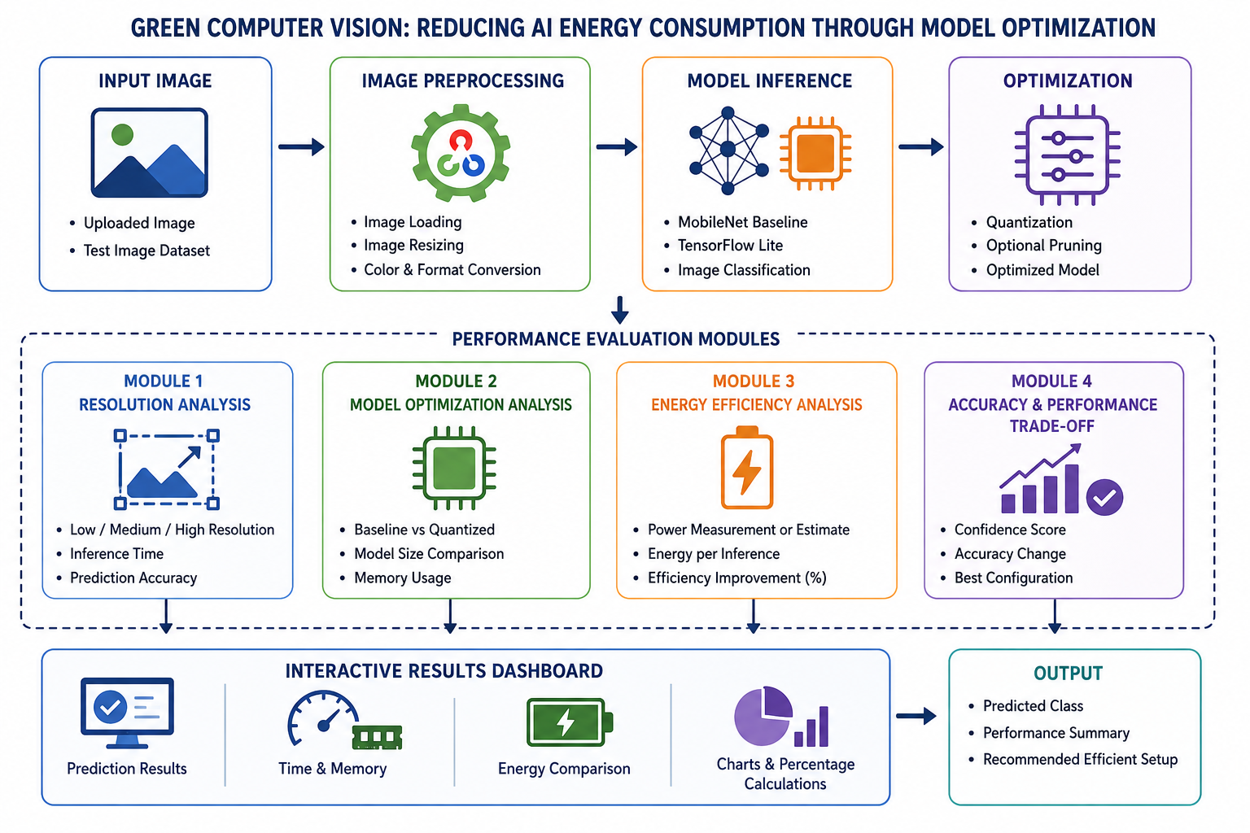
SYSTEM ARCHITECTURE

Slide 7
GREEN COMPUTER VISION OPTIMIZATION
Accepts input images and applies preprocessing using OpenCV.
Tests different image resolutions to evaluate computational efficiency.
Performs image classification using a pretrained MobileNet model.
Applies quantization to reduce model size and resource requirements.
Measures accuracy, inference time, memory usage and energy consumption.
Displays comparative results and efficiency calculations through an interactive dashboard.

Slide 8
TOOLS & TECHNOLOGIES
Programming & Web Development
Python – Core programming
HTML5 – Webpage structure
CSS3 – Dashboard styling
JavaScript – Interactivity
Flask – Backend integration
Computer Vision & Deep Learning
OpenCV – Image processing
MobileNet – Image classification
TensorFlow – Model execution
TensorFlow Lite – Model optimization
NumPy – Numerical calculations
Model Optimization Techniques
Quantization – Reduced precision
Pruning – Weight reduction
Image Resizing – Resolution optimization
Image Preprocessing – Input preparation
Performance Evaluation & Visualization
Matplotlib – Graph plotting
Plotly – Interactive charts
Time Measurement – Inference speed
Memory Profiling – Memory usage
Energy Measurement – Power consumption

Slide 9
REAL - WORLD APPLICATIONS
1. Smart Surveillance Systems
Efficient object recognition in CCTV systems can help reduce computing requirements in continuous monitoring applications.
2. Smart Agriculture
Optimized vision models can support crop disease detection, pest identification and plant monitoring on low-power devices.
3. Healthcare and Medical Imaging
Efficient image-classification models can support medical image analysis on portable or resource-constrained devices, subject to appropriate clinical validation.
4. Industrial Inspection
Lightweight vision systems can detect product defects and identify manufacturing issues while reducing processing overhead.
5. Edge AI and IoT Devices
Optimized computer vision enables image recognition on smart cameras, embedded systems, drones and mobile devices with limited computing resources.

Slide 10
THANK YOU!
ANY QUESTIONS?

